Slide 1
What is cloud native security?

Slide 2
Learn things in detail
for both offensive and defensive security, knowing an area in depth is hugely important
separates the script kiddies from the experts
the security issues are on the boundaries of the usual
play, understand, break, fix

Slide 3
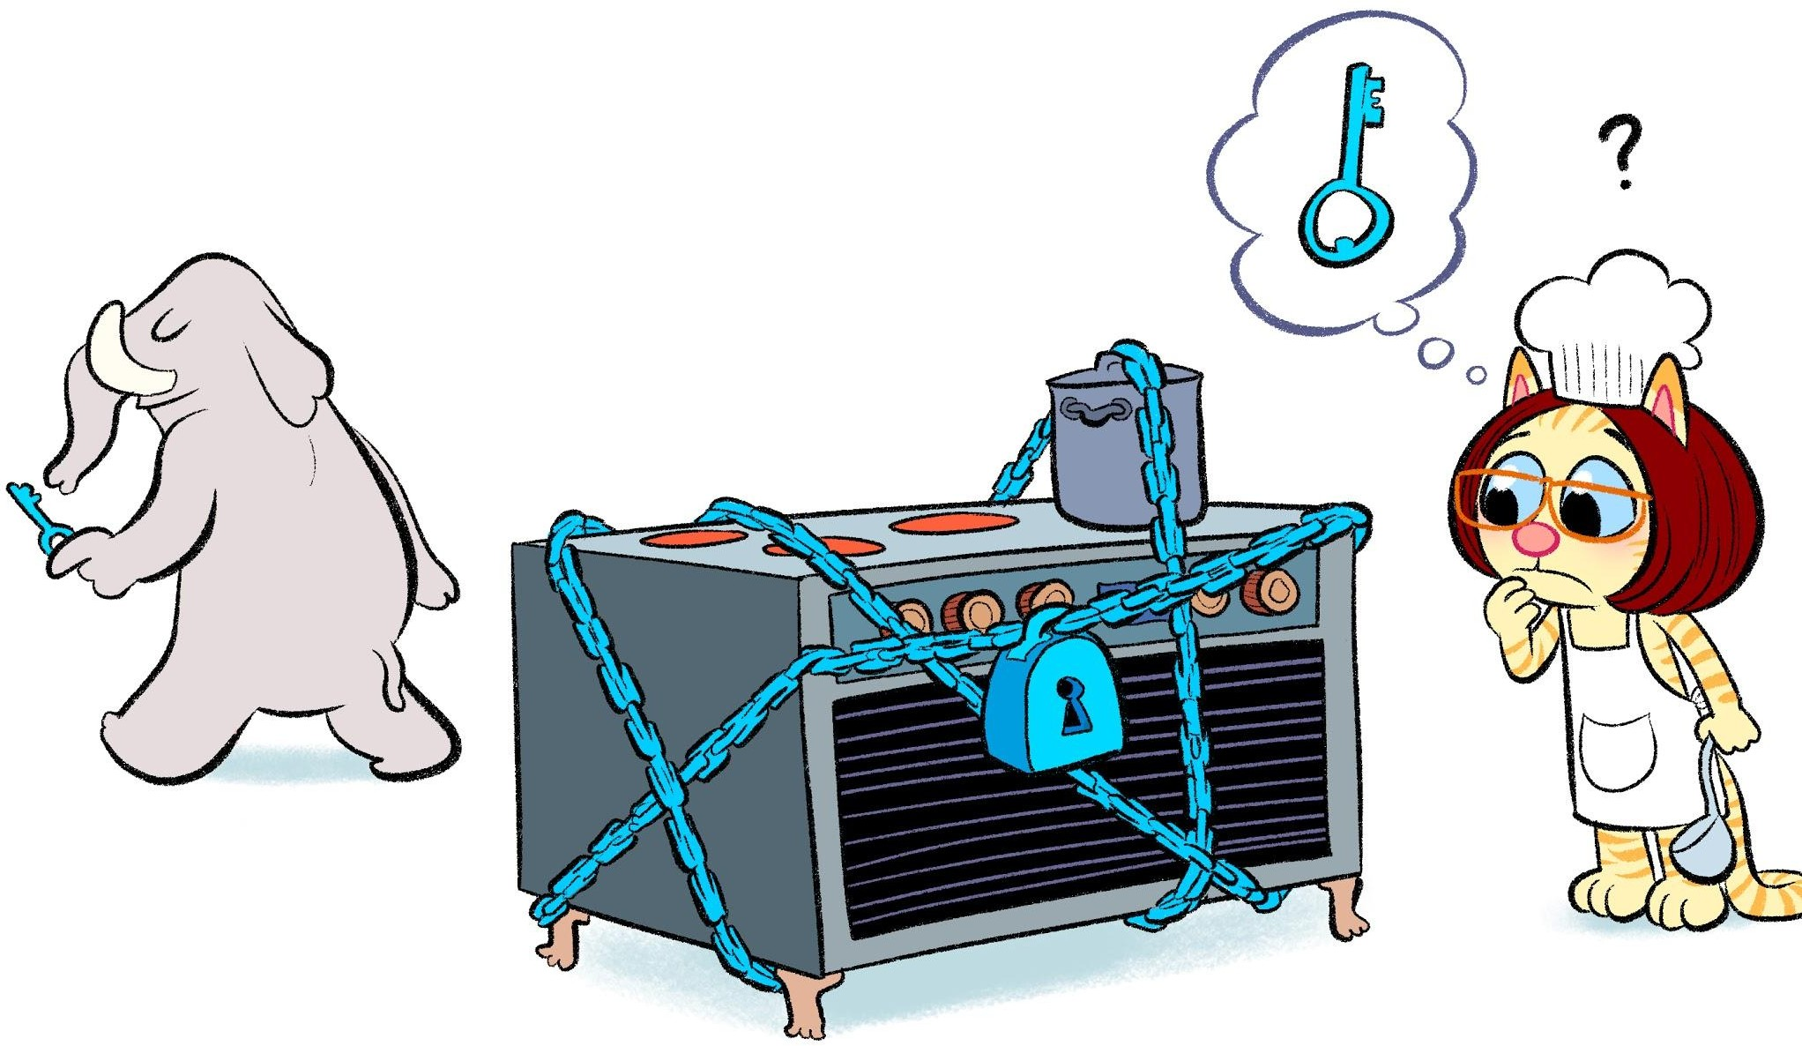
Spend time in the real world
empathy
security is unimportant most of the time
the best security is just there supporting people, it is not extra work for them

Slide 4

Break and fix
just breaking things is not sufficient
fixing things is much harder
you get exposed to the world of compromise
wanting to burn everything down is a fine thing, but it's not going to happen 🔥

Slide 5
Meet the team
security is not just an engineering job
get to meet your legal team
and your PR team
and sell security to the business
and compromise
work with product team

Slide 6
Everything is code...
before cloud we had security in hardware
firewalls
physical cables
data diode
now everything can be reconfigured in code
this changes everything...

Slide 7
Implications
cannot separate security from development or operations DevSecOps
everything changes much faster
new places to attack, eg supply chain
dev and ops must get involved

Slide 8
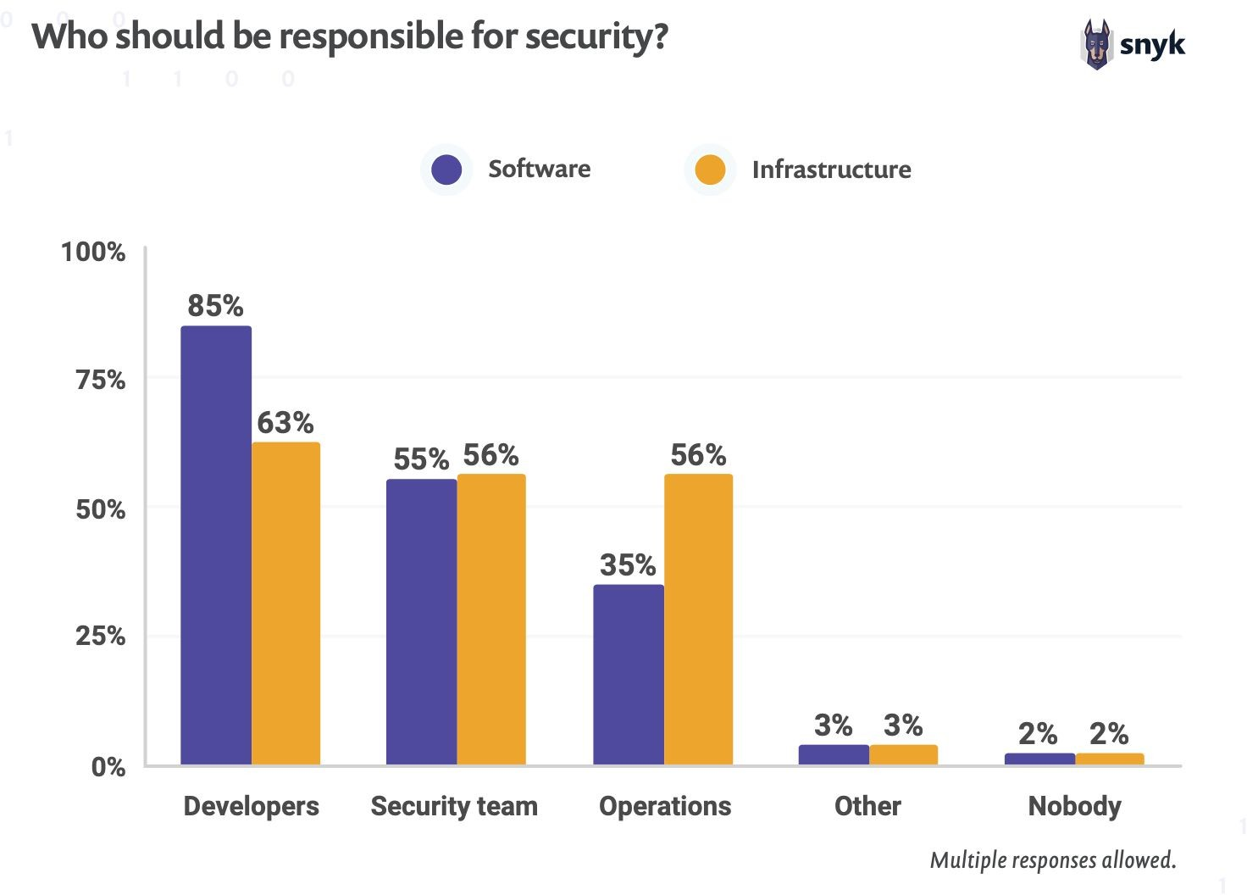
DevSecOps

Slide 9

Security in your code
understand the threat model
security is quality
handle errors and the unexpected
understand the issues in domain
write security tests
think like an attacker
spend time attacking
learn from external audits

Slide 10

Burnout in security roles
you cannot tell anyone about what you do a lot of the time
not enough people, so often overworked
live away from the happy path

